Slide 1

Analog Electronics
Ch 3 Bipolar Junction Transistors
3.1 Introduction of BJT
3.2 Single-Stage BJT Amplifiers
3.3 Frequency Response
3.4 Power Amplifiers

Slide 2
Ch 3 Bipolar Junction Transistor
3.1 Introductions of BJT
This lecture will spend some time on understanding how the bipolar junction transistor (BJT) works based on what we have known about PN junctions. One way to look at a BJT transistor is two back-to-back diodes, but it has very different characteristics.
Once we understand how the BJT device operates, we will take a look at the different circuits (amplifiers) which we can build.

Slide 3
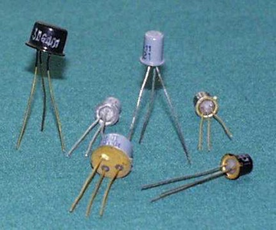
Ch 3 Bipolar Junction Transistor
3.1 Introduction of BJT

Slide 4
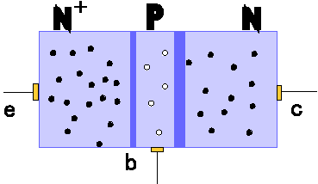
Ch 3 Bipolar Junction Transistor
3.1 Introduction of BJT
Construction of Bipolar junction transistors
Emitter-base junction
Base region
(very narrow)
Emitter region
Collector
Collector region
Emitter
Base
Collector-base junction

Slide 5
Ch 3 Bipolar Junction Transistor
3.1 Introduction of BJT
Construction of Bipolar junction transistors
NPN BJT shown
• 3 terminals: emitter, base, and collector
• 2 junctions: emitter-base junction (EBJ) and collector-base junction (CBJ)
– These junctions have capacitance (high-frequency model)
BJTs are not symmetric devices
– doping and physical dimensions are different for emitter
and collector

Slide 6
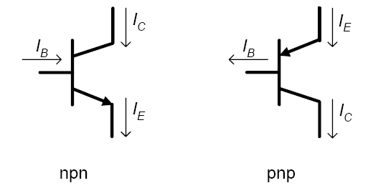
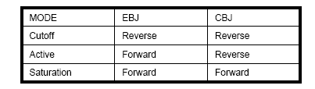
Ch 3 Bipolar Junction Transistor
3.1 Introduction of BJT
Standard bipolar junction transistor symbols
Depending on the biasing across each of the junctions, different modes of operation are obtained – cutoff, active and saturation

Slide 7
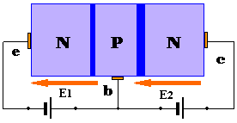
Ch 3 Bipolar Junction Transistor
3.1 Introduction of BJT
BJT in Active Mode
Two external voltage sources set the bias conditions for active mode
– EBJ is forward biased and CBJ is reverse biased

Slide 8
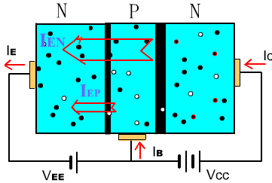
Ch 3 Bipolar Junction Transistor
3.1 Introduction of BJT
BJT in Active Mode
I_{E}＝I_{EN}＋I_{EP}≈ I_{EN}
Forward bias of EBJ injects electrons from emitter into base (small number of holes injected from base into emitter)

Slide 9
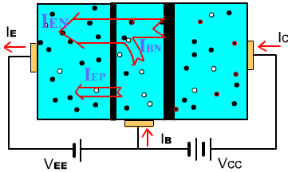
Ch 3 Bipolar Junction Transistor
3.1 Introduction of BJT
BJT in Active Mode
I_{B} ＝I_{BN}＋ I_{EP}
Most electrons shoot through the base into the collector
across the reverse bias junction
Some electrons recombine with majority carrier in (P-type)
base region

Slide 10
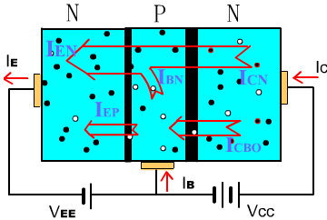
Ch 3 Bipolar Junction Transistor
3.1 Introduction of BJT
BJT in Active Mode
I_{C} = I_{CN} + I_{CBO}
Electrons that diffuse across the base to the CBJ junction are swept across the CBJ depletion region to the collector.

Slide 11
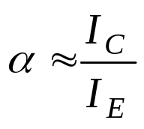
Ch 3 Bipolar Junction Transistor
3.1 Introduction of BJT
BJT in Active Mode
I_{E}＝I_{EN}＋I_{EP}≈ I_{EN}
I_{C} = I_{CN} + I_{CBO}
I_{E} = I_{B} + I_{C}
Let I_{CN}＝αI_{E}
I_{B}＝I_{BN}＋I_{EP}
I_{C} (1－α) = αI_{B} + I_{CBO}
---common-base current gain

Slide 12
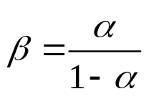

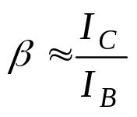
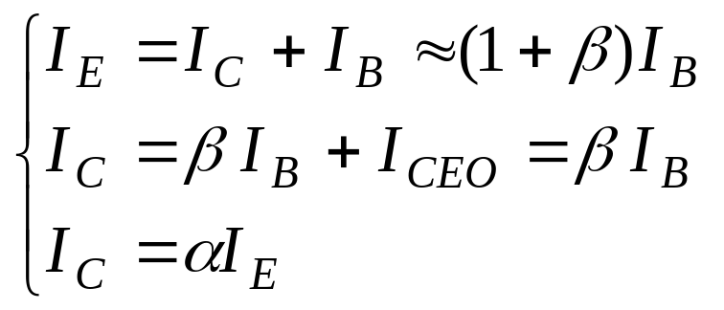
Ch 3 Bipolar Junction Transistor
3.1 Introduction of BJT
BJT in Active Mode
I_{E}＝I_{EN}＋I_{EP}≈ I_{EN}
I_{B}＝I_{BN}＋I_{EP}
I_{C}=I_{CN}+I_{CBO}
I_{E}=I_{B}+I_{C}
I_{C} (1－α)= αI_{B}+I_{CBO}
Let
Beta:
---common-emitter current gain

Slide 13
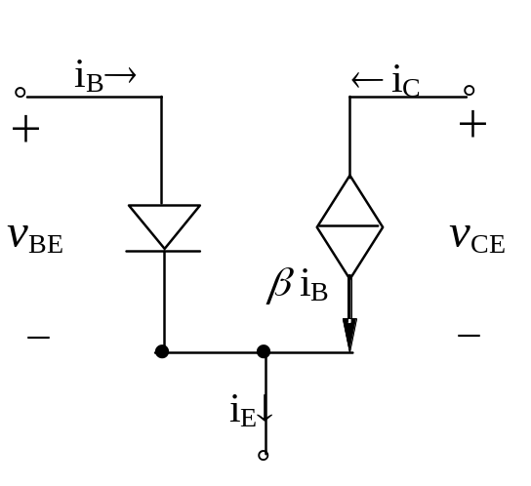
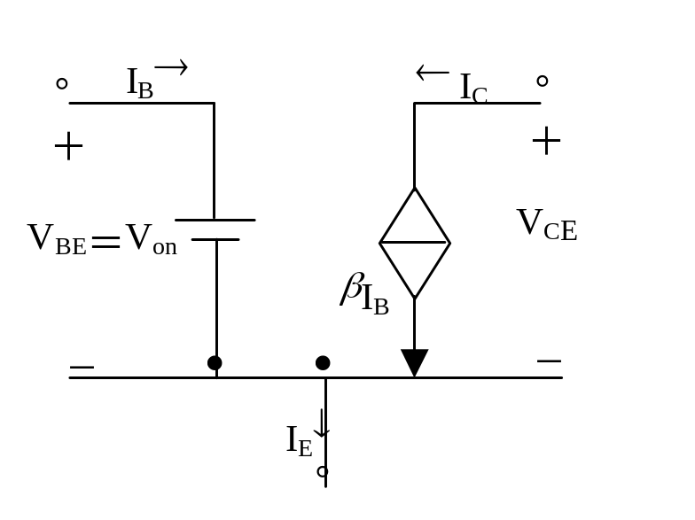
Ch 3 Bipolar Junction Transistor
3.1 Introduction of BJT
BJT Equivalent Circuits
BJT DC model
Use a simple constant-V_{BE} model
– Assume V_{BE} = 0.7V

Slide 14
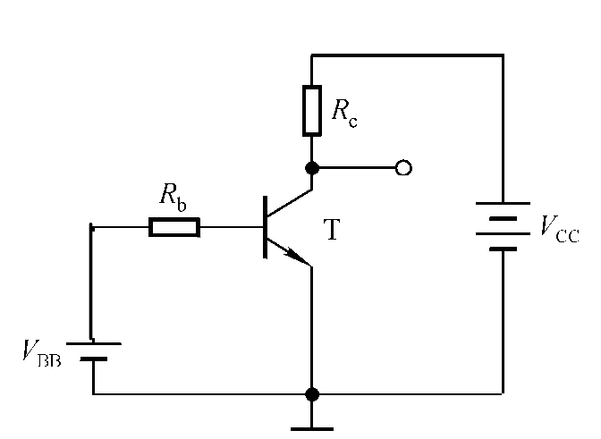
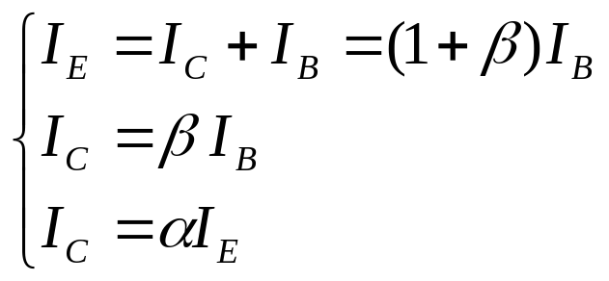
Ch 3 Bipolar Junction Transistor
3.1 Introduction of BJT
BJT DC Analysis
• Make sure the BJT current equations and region of operation match
V_{BE} > 0,
V_{BC} < 0, → V_{E} < V_{B} <V_{C}
• Utilize the relationships (β and α) between collector, base, and emitter currents to solve for all currents

Slide 15
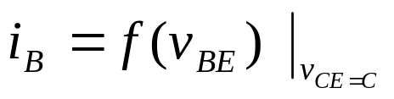
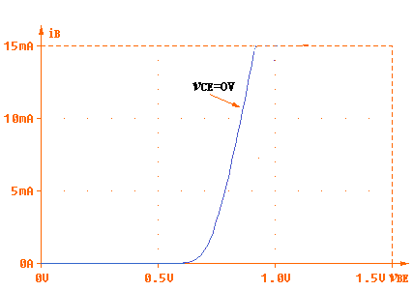
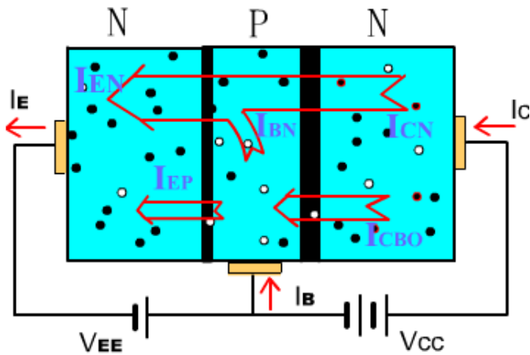
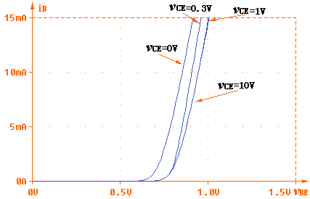
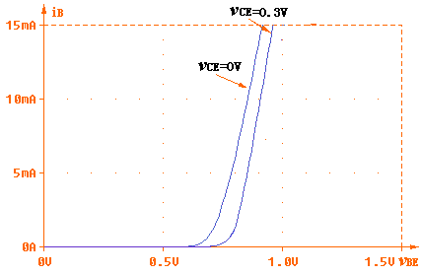
Ch 3 Bipolar Junction Transistor
3.1 Introduction of BJT
C-E Circuits I-V Characteristics
Base-emitter Characteristic(Input characteristic)

Slide 16
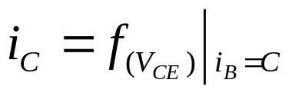

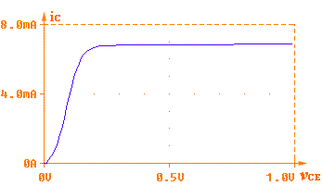
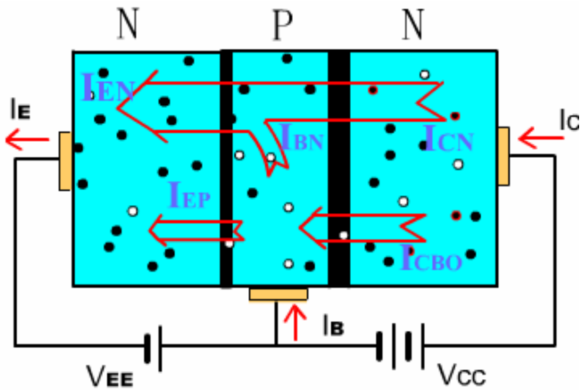
Ch 3 Bipolar Junction Transistor
3.1 Introduction of BJT
C-E Circuits I-V Characteristics
Collector characteristic (output characteristic)

Slide 17
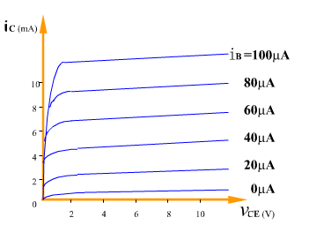
Ch 3 Bipolar Junction Transistor
3.1 Introduction of BJT
C-E Circuits I-V Characteristics
Collector characteristic (output characteristic)

Slide 18
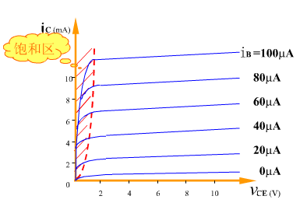
Ch 3 Bipolar Junction Transistor
3.1 Introduction of BJT
C-E Circuits I-V Characteristics
Collector characteristic
Saturation
Saturation occurs when the supply voltage, V_{CC,} is across the total resistance of the collector circuit, R_{C}.
I_{C(sat)} = V_{CC}/R_{C}
V_{sat}
Once the base current is high enough to produce saturation, further increases in base current have no effect on the collector current and the relationship I_{C} = βI_{B} is no longer valid. When V_{CE} reaches its saturation value, V_{CE(sat)}, the base-collector junction becomes forward-biased.

Slide 19
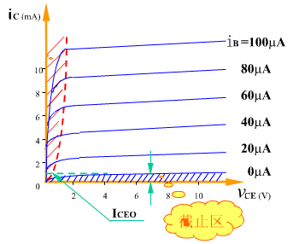
Ch 3 Bipolar Junction Transistor
3.1 Introduction of BJT
C-E Circuits I-V Characteristics
Collector characteristic
When I_{B} = 0, the transistor is in cutoff and there is essentially no collector current except for a very tiny amount of collector leakage current, I_{CEO}, which can usually be neglected. I_{C} ≈ 0.
In cutoff both the base-emitter and the base-collector junctions are reverse-biased.
Cutoff

Slide 20
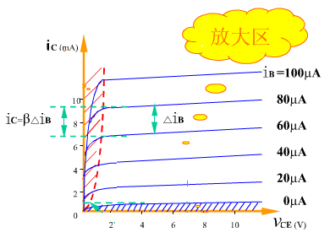
Ch 3 Bipolar Junction Transistor
3.1 Introduction of BJT
C-E Circuits I-V Characteristics
Collector characteristic
linearity

Slide 21
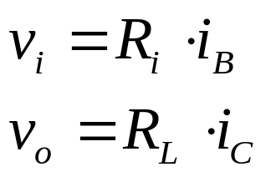
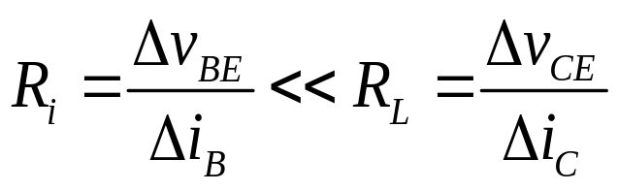
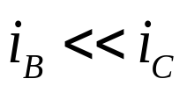
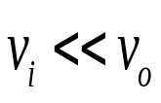
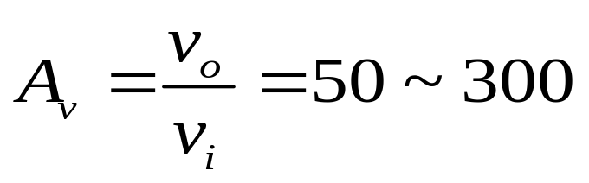
Ch 3 Bipolar Junction Transistor
3.1 Introduction of BJT
Discussion of an amplification effect
With
E.g. for common-base configuration transistor:

Slide 22
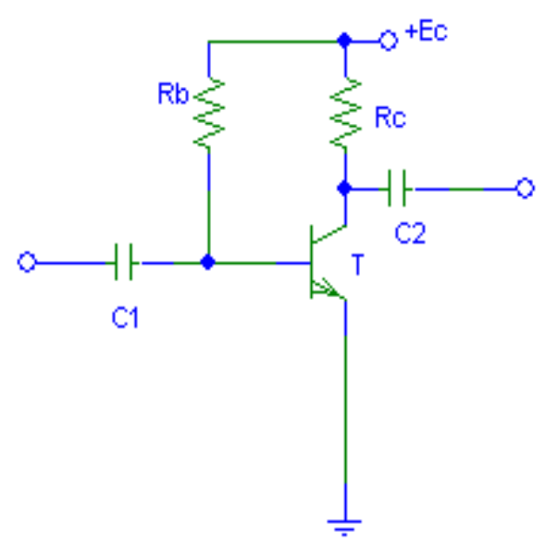
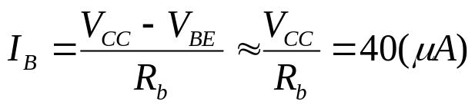

Ch 3 Bipolar Junction Transistor
3.1 Introduction of BJT
DC Load Line and Quiescent Operation Point
Q-point
V_{CC}
.Q
I_{CQ}
V_{CEQ}
Base-emitter loop:
DC load line
Collector-emitter loop:

Slide 23
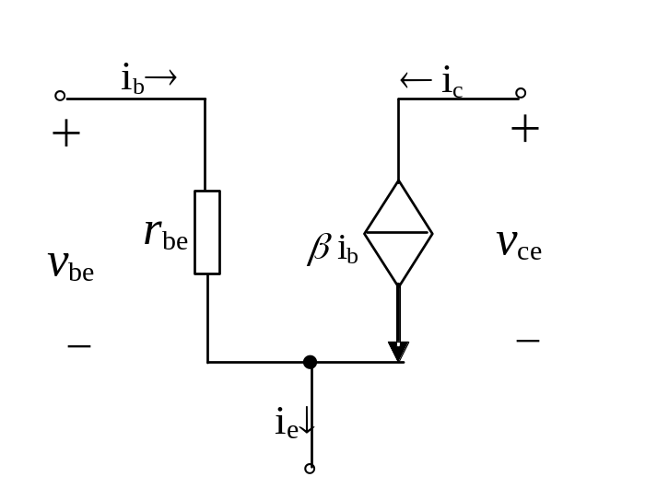
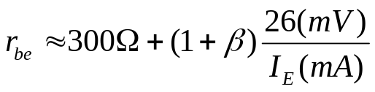

Ch 3 Bipolar Junction Transistor
3.1 Introduction of BJT
BJT AC Small-Signal Model
We can create an equivalent circuit to model the transistor for small signals
– Note that this only applies for small signals (v_{be} < V_{T})
We can represent the small-signal model for the transistor as a voltage controlled
current source ( ) or a current-controlled current source (i_{c} = βi_{b}).
For small enough signals, approximate exponential curve with a linear line.

Slide 24
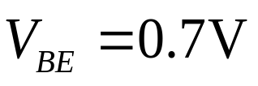
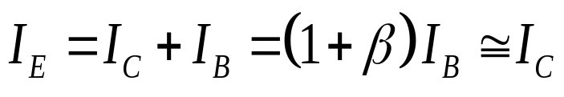
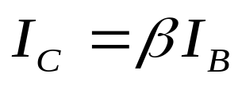
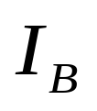


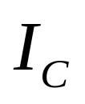

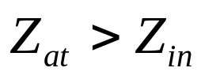

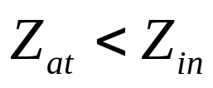


Ch 3 Bipolar Junction Transistor
3.1 Introduction of BJT
BJT fundamentals:
Summary for three types of diodes:
 | C-C | C-E | C-B
Input
Output
Functions

Slide 25
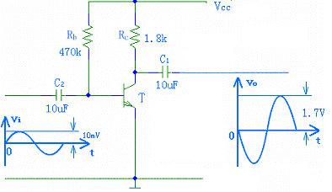



Ch 3 Bipolar Junction Transistor
3.2 Single-Stage BJT Amplifiers
C-E Amplifiers
To operate as an amplifier, the BJT must be biased to operate in active mode and then superimpose a small voltage signal v_{be} to the base.
DC + small signal
coupling capacitor
(only passes ac signals)

Slide 26
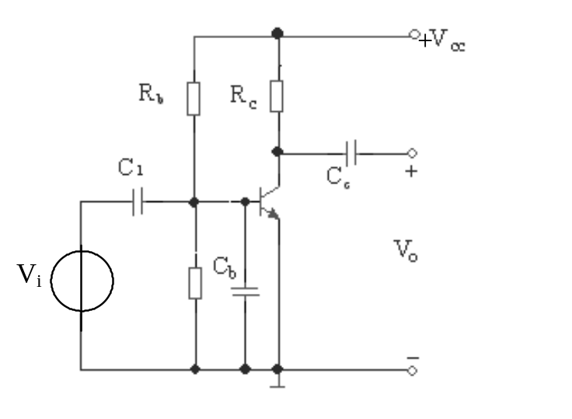
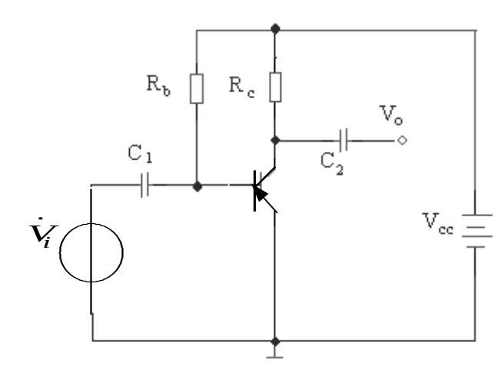
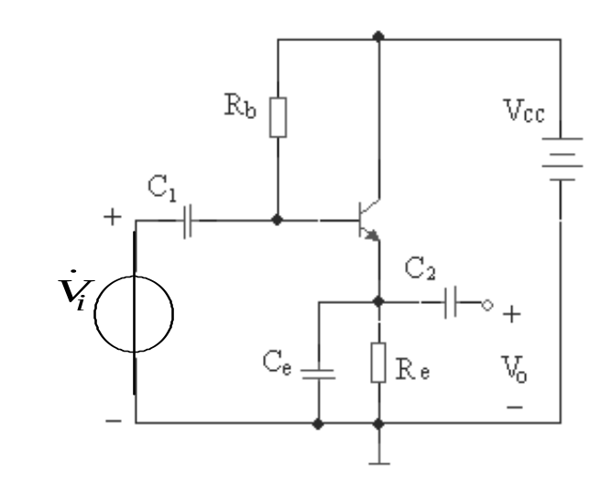
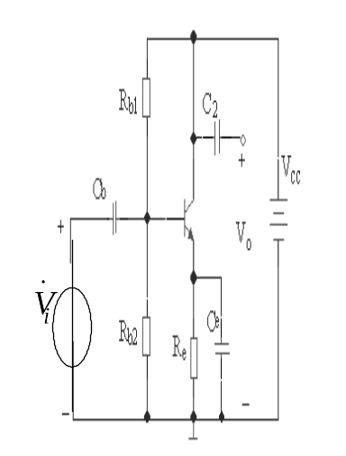
Ch 3 Bipolar Junction Transistor
3.2 Single-Stage BJT Amplifiers
C-E Amplifiers

Slide 27
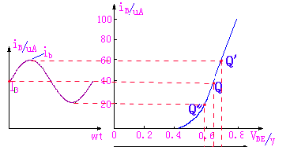



Ch 3 Bipolar Junction Transistor
3.2 Single-Stage BJT Amplifiers
C-E Amplifiers
Apply a small signal input voltage and see i_{b}
v_{BE}=v_{i}+V_{BE}

Slide 28




Ch 3 Bipolar Junction Transistor
3.2 Single-Stage BJT Amplifiers
C-E Amplifiers
See how i_{b} translates into v_{ce.}
v_{i} = 0 → I_{B}、I_{C}、V_{CE}
i_{C}=i_{c}+I_{C}
v_{o} out of phase with v_{i}
v_{CE}=v_{ce}+V_{CE}

Slide 29





Ch 3 Bipolar Junction Transistor
3.2 Single-Stage BJT Amplifiers
C-E Amplifiers
Considering (all the capaertors are replaced by open circuits)
Considering (all the capaertors are replaced by short circuits)

Slide 30




Ch 3 Bipolar Junction Transistor
3.2 Single-Stage BJT Amplifiers
C-E Amplifiers
Considering (all the capaertors are replaced by open circuits)
Considering (all the capaertors are replaced by short circuits)

Slide 31

Ch 3 Bipolar Junction Transistor
3.2 Single-Stage BJT Amplifiers
Graphical Analysis
Can be useful to understand the operation of BJT
circuits.
• First, establish DC conditions by finding I_{B} (or V_{BE})
• Second, figure out the DC operating point for I_{C}
V_{CC}
Can get a feel for whether the BJT will stay in active region of operation
– What happens if R_{C} is larger or smaller?

Slide 32




Ch 3 Bipolar Junction Transistor
3.2 Single-Stage BJT Amplifiers
Graphical Analysis
V′_{CC}

Slide 33


Ch 3 Bipolar Junction Transistor
3.2 Single-Stage BJT Amplifiers
Graphical Analysis
Q-point is centered on the ac load line:
V′_{CC}

Slide 34


Ch 3 Bipolar Junction Transistor
3.2 Single-Stage BJT Amplifiers
Graphical Analysis
Q-point closer to cutoff:
V′_{CC}
Clipped at cutoff
(cutoff distortion)

Slide 35


Ch 3 Bipolar Junction Transistor
3.2 Single-Stage BJT Amplifiers
Graphical Analysis
Q-point closer to saturation:
V′_{CC}
Clipped at cutoff
(saturation distortion)

Slide 36


Ch 3 Bipolar Junction Transistor
3.2 Single-Stage BJT Amplifiers
Graphical Analysis

Slide 37
Ch 3 Bipolar Junction Transistor
3.2 Single-Stage BJT Amplifiers
Small-Signal Models Analysis
Steps for using small-signal models
1. Determine the DC operating point of the BJT
－ in particular, the collector current
2. Calculate small-signal model parameters: r_{be}
3. Eliminate DC sources
– replace voltage sources with shorts and current
sources with open circuits
4. Replace BJT with equivalent small-signal models
5. Analysis

Slide 38



Ch 3 Bipolar Junction Transistor
3.2 Single-Stage BJT Amplifiers
Small-Signal Models Analysis
Example 1
I_{C} ≈ βI_{B},
I_{E} = I_{C} + I_{B} = (1+β)I_{B}

Slide 39

Ch 3 Bipolar Junction Transistor
3.2 Single-Stage BJT Amplifiers
Small-Signal Models Analysis
Example 1

Slide 40





Ch 3 Bipolar Junction Transistor
3.2 Single-Stage BJT Amplifiers
Small-Signal Models Analysis
Example 2

Slide 41




Ch 3 Bipolar Junction Transistor
3.2 Single-Stage BJT Amplifiers
Small-Signal Models Analysis
There are three basic configurations for single-stage BJT amplifiers:
– Common-Emitter
– Common-Base
– Common-Collector

Slide 42











Ch 3 Bipolar Junction Transistor
3.2 Single-Stage BJT Amplifiers
Common-Collector Amplifier
Note : is slightly less than due to the voltage drop introduced by

Slide 43

Ch 3 Bipolar Junction Transistor
3.2 Single-Stage BJT Amplifiers
Common-Collector Amplifier
The last basic configuration is to tie the collector to a fixed voltage, drive an input signal into the base and observe the output at the emitter.

Slide 44



Ch 3 Bipolar Junction Transistor
3.2 Single-Stage BJT Amplifiers
Common-Collector Amplifier
Let’s find A_{v，} A_{i}：

Slide 45







Ch 3 Bipolar Junction Transistor
3.2 Single-Stage BJT Amplifiers
Common-Collector Amplifier
Let’s find A_{v，} A_{i}：
<< R_{b}
>>1

Slide 46



Ch 3 Bipolar Junction Transistor
3.2 Single-Stage BJT Amplifiers
Common-Collector Amplifier
Let’s find R_{i}：

Slide 47











Ch 3 Bipolar Junction Transistor
3.2 Single-Stage BJT Amplifiers
Common-Collector Amplifier
Let’s find R_{o}：

Slide 48



Ch 3 Bipolar Junction Transistor
3.2 Single-Stage BJT Amplifiers
Common-Collector Amplifier

Slide 49

Ch 3 Bipolar Junction Transistor
3.2 Single-Stage BJT Amplifiers
Common-Collector Amplifier
>>1
C-C amp characteristics:
Gain is less than unity, but close (to unity) since β is large and r_{be} is small.
Also called an emitter follower since the emitter follows the input signal.
Input resistance is higher, output resistance is lower.
- Used for connecting a source with a large R_{s} to a load with low
resistance.

Slide 50






Ch 3 Bipolar Junction Transistor
3.2 Single-Stage BJT Amplifiers
Common-Base Amplifier
Ground the base and drive the input signal into the emitter

Slide 51






Ch 3 Bipolar Junction Transistor
3.2 Single-Stage BJT Amplifiers
Common-Base Amplifier
R_{i}=
For R_{L}<<R_{C},
R_{o}≈R_{C}

Slide 52




Ch 3 Bipolar Junction Transistor
3.2 Single-Stage BJT Amplifiers
Common-Base Amplifier
For R_{L}<<R_{C},
R_{i}=
R_{o}≈R_{C}
CB amp characteristics:
current gain has little dependence on β
is non-inverting
most commonly used as a unity-gain current amplifier or current buffer and not
as a voltage amplifier: accepts an input signal current with low input resistance
and delivers a nearly equal current with high output impedance
most significant advantage is its excellent frequency response

Slide 53

Ch 3 Bipolar Junction Transistor
3.3 Frequency Response
Basic Concepts
1.0V
0.5V
0V
-0.5V
-1.0V
0.5ms
1.0ms
1.5ms
2.0ms
2.5ms
3.0ms
3.5ms
4.0ms
V(1)
V(2)
Time

Slide 54

Ch 3 Bipolar Junction Transistor
3.3 Frequency Response
Basic Concepts
1.0V
0.5V
0V
-0.5V
-1.0V
0.5ms
1.0ms
1.5ms
2.0ms
2.5ms
3.0ms
3.5ms
4.0ms
V(1)
V(2)
Time

Slide 55

Ch 3 Bipolar Junction Transistor
3.3 Frequency Response
Basic Concepts
800mV
600mV
400mV
200mV
0V
0Hz
2KHz
4KHz
6KHz
8KHz
10KHz
12KHz
14KHz
16KHz
18KHz
20KHz
V(2)
V(1)
Frequency

Slide 56



Ch 3 Bipolar Junction Transistor
3.3 Frequency Response
Basic Concepts
Lower cut off frequency
Upper cut off frequency
The drops of voltage gain (output/input) is mainly due to:
1、Increasing reactance of (at low f)
2、Porasitic capacetine elements of the net work (at high f)
3、Dissappearance of changing current(for trasformer coupled amp)

Slide 57


Ch 3 Bipolar Junction Transistor
3.3 Frequency Response
High-Frequency BJT Model
In BJTs, the PN junctions (EBJ and CBJ) also have capacitances associated with them
C_{μ}
r_{be}
C_{π}
r_{be}
C'_{π}
C'_{μ}

Slide 58
Ch 3 Bipolar Junction Transistor
3.3 Frequency Response
Frequency Response of the CE Amplifier
r_{be}
C'_{π}
C'_{μ}
There are three capacitors in the circuit.
At the mid frequency band, these are considered to be short circuits and internal capacitors and are considered to be open circuits.
C'_{π,}
C'_{μ}

Slide 59



Ch 3 Bipolar Junction Transistor
3.3 Frequency Response
Frequency Response of the CE Amplifier
At low frequencies, C_{1,} C₂ are an open circuit and the gain is zero. Thus C₁ has a high pass effect on the
gain, i.e. it affects the lower cutoff frequency of the amplifier.
τ₂ is the time constant for C₂.
---is neglected

Slide 60



Ch 3 Bipolar Junction Transistor
3.3 Frequency Response
Frequency Response of the CE Amplifier
---is neglected
Capacitor Ce is an open circuit. The pole time constant is given by the resistance multiplied by Ce.

Slide 61





Ch 3 Bipolar Junction Transistor
3.3 Frequency Response
Frequency Response of the CE Amplifier
At high frequencies, C_{1,} C₂ C_{e} are all short circuit.
The frequency that dominates is the
lowest pole frequency.
The time constant is neglected for
C'_{μ}
r_{be}
C'_{π}
C'_{μ}
In summary:the lower cut off frequency is determined by network capacitence.
e.g. The higher cut off frequency is determined by the parasitic ferquency of the BJT. e.g.

Slide 62



Ch 3 Bipolar Junction Transistor
3.3 Frequency Response
Frequency Response of the CE Amplifier
r_{be}
C'_{π}
C'_{μ}

Slide 63

Ch 3 Bipolar Junction Transistor
3.3 Frequency Response
Frequency Response of the CE Amplifier
r_{be}
C'_{π}
C'_{μ}

Slide 64

Ch 3 Bipolar Junction Transistor
3.3 Frequency Response
Frequency Response of the CE Amplifier
decade
decade
0

Slide 65
Ch 3 Bipolar Junction Transistor
3.4 Power Amplifiers
An Analog Electronics System Block
Sensor
Voltage Amplifiers
Power Amplifiers
Load
Energy conversion
Signal Amplifiers
Energy conversion

Slide 66



Ch 3 Bipolar Junction Transistor
3.4 Power Amplifiers
The output power delivered to the load R_{L}:
The average power delivered by the supply:
The efficiency in converting supply power to useful output power is defined as

Slide 67


Ch 3 Bipolar Junction Transistor
3.4 Power Amplifiers
Power Calculation
The DC power by the supply
The DC power delivered to BJT by the supply

Slide 68

Ch 3 Bipolar Junction Transistor
3.4 Power Amplifiers
Power Calculation
The average power dissipated as heat in the BJT:

Slide 69


Ch 3 Bipolar Junction Transistor
3.4 Power Amplifiers
Class-A Amplifiers
Class-B Amplifiers

Slide 70

Ch 3 Bipolar Junction Transistor
3.4 Power Amplifiers
Class-AB Amplifiers

Slide 71

Ch 3 Bipolar Junction Transistor
3.4 Power Amplifiers
Complementary Symmetry Power Amplifier (Class-B)

Slide 72





Ch 3 Bipolar Junction Transistor
3.4 Power Amplifiers
Complementary Symmetry Power Amplifier (Class-B)

Slide 73











Ch 3 Bipolar Junction Transistor
3.4 Power Amplifiers
Complementary Symmetry Power Amplifier (Class-B)
Assuming
→
for
Note: represents the amount of power dissipated by the BJT as heat

Slide 74



Ch 3 Bipolar Junction Transistor
3.4 Power Amplifiers
Complementary Symmetry Power Amplifier (Class-B)
=78.5%
Note that for class A: η﹦25﹪ ~ 50﹪
class B: η﹦78.5﹪
class AB: η=25﹪ ~ 78.5﹪

Slide 75



Ch 3 Bipolar Junction Transistor
3.4 Power Amplifiers
Complementary Symmetry Power Amplifier (Class-B)
Crossover distortion

Slide 76




Ch 3 Bipolar Junction Transistor
3.4 Power Amplifiers
Biasing the Push-Pull Amplifier (Class-AB) (OCL)
To overcome crossover distortion, the biasing is adjusted to just overcome the V_{BE} of the transistors; this results in a modified form of operation called class AB. In class AB operation, the push-pull stages are biased into slight conduction, even when no input signal is present.
}V_{CC}
}V_{CC}
Power Calculation is the same as class-B

Slide 77

Ch 3 Bipolar Junction Transistor
3.4 Power Amplifiers
Single-Supply Push-Pull Amplifier (OTL)
The circuit operation is the same as that described previously, except the bias is set to force the output emitter voltage to be V_{CC}/2 instead of zero volts used with two supplies. Because the output is not biased at zero volts, capacitive coupling for the input and output is necessary to block the bias voltage from the source and the load resistor.

